Slide 1
Nonequilibrium phase diagram of an atom-cavity system with three-level atoms
Paul Haffner

Slide 2
Contents
Theoretical backgrounds:
Quantum systems – Time crystals – Dark states - EIT
Framework and quations of motion
Phase diagram
Outlook and conclusion

Slide 3
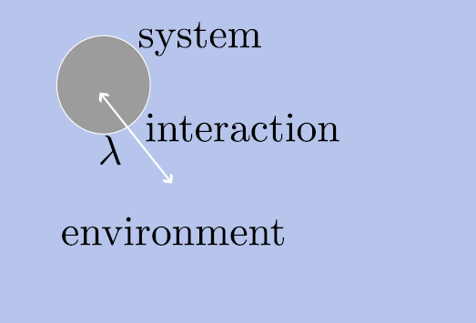
Theoretical background: Quantum systems
Open quantum systems interact with their environment.
Their evolution is not purely unitary [1].
There can be influenced by e.g. driving fields or dissipation.
[1] H.-P. Breuer and F. Petruccione, The theory of open quantum systems (2002)

Slide 4
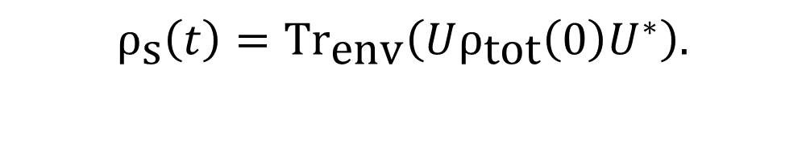
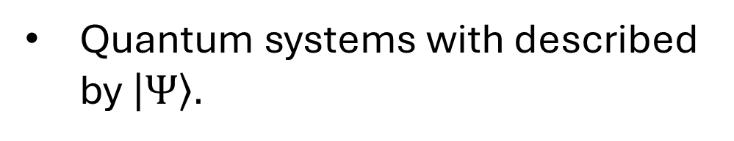


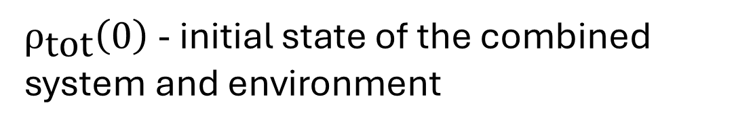
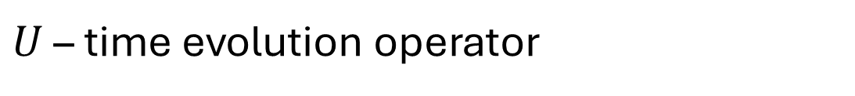
Quantum systems with described by $\left|Ψ\right\rangle .$
$$iℏ\frac{∂}{∂t} |Ψ(t)⟩=H|Ψ(t)⟩$$
$H_{\text{sys}}$ - represents the „isolated“ system only
With $H=H_{\text{sys}}+H_{\text{env}}+λH_{\text{int}}.$
$H_{\text{env}}$ - is the Hamiltonian of the environment alone
$H_{\text{int}}$ - interaction between bath and system
$λ$ - adimensional constant representing interaction strength
Reduced system state is
$U$ – time evolution operator
$$ρ_{\text{s}}\left(t\right)=\text{T}{\text{r}}_{\text{env}}\left(Uρ_{\text{tot}}\left(0\right)U^{∗}\right).$$
$ρ_{\text{tot}}\left(0\right)$ - initial state of the combined system and environment
Challenging or impossible to solve in most cases !
Notes:
(hier klarstellen ganzes system) psi nicht nur von system oder env
(etwas genauer beschreiben was ich genau meine)

Slide 5
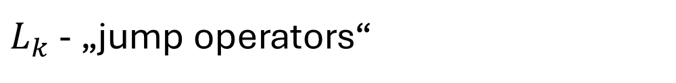
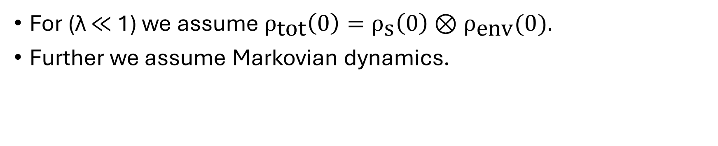

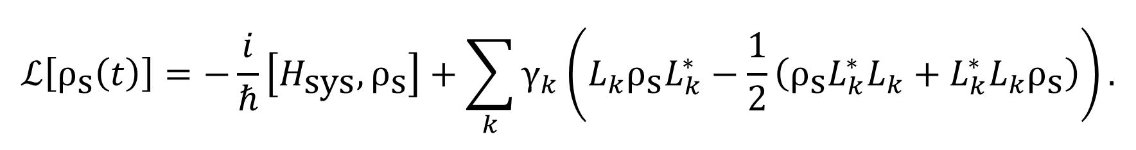
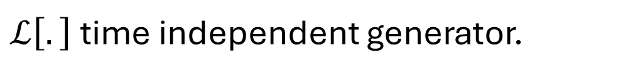
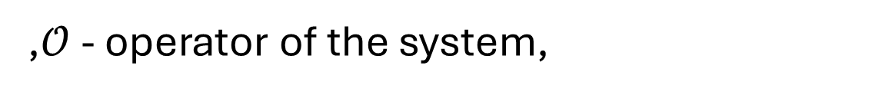

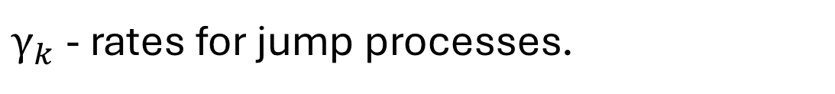
For (λ ≪ 1) we assume $ρ_{\text{tot}}\left(0\right)=ρ_{\text{s}}\left(0\right)⊗ρ_{\text{env}}(0).$
Further we assume Markovian dynamics.
This simplifies the analysis significantly!
$$\frac{d}{dt}ρ_{\text{s}}\left(t\right)=ℒ\left[ρ_{\text{s}}\left(t\right)\right].$$
$ℒ\left[.\right]$time independent generator.
Its action on the density operator is given by
$$ℒ\left[ρ_{\text{s}}\left(t\right)\right]=−\frac{i}{ℏ}\left[H_{\text{sys}},ρ_{\text{s}}\right]+\sum_{k}{γ_{k}\left(L_{k}ρ_{\text{s}}L_{k}^{∗}−\frac{1}{2}\left(ρ_{\text{s}}L_{k}^{∗}L_{k}+L_{k}^{∗}L_{k}ρ_{\text{s}}\right)\right)}.$$
The adjoint action is given by
$$ℒ^{∗}\left[𝒪\right]=\dot{𝒪}=\frac{i}{ℏ}\left[H,𝒪\right]+\sum_{n}{γ_{n}\left(L_{n}^{∗}𝒪L_{n}−\frac{1}{2}\{L_{n}^{∗}L_{n},𝒪\}\right)}.$$
$L_{k}$ - „jump operators“
,$𝒪$ - operator of the system,
$γ_{k}$ - rates for jump processes.
Notes:
assum both the system and its environment ex-
hibit Markovian dynamics.

Slide 6
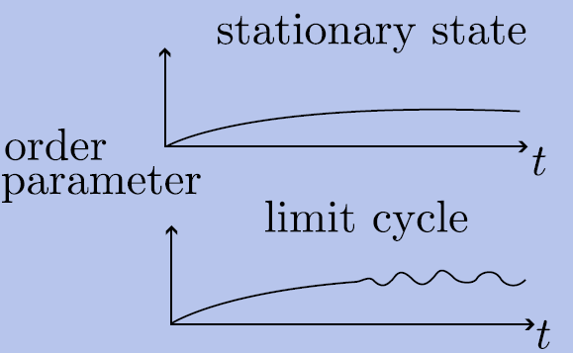
Theoretical background: Time crystals
Many systems relax into stationary states.
Instead of relaxing to a stationary state, some systems exhibit periodic oscillations [1,2].
They break temporal translation symmetry [1,2].
[1] F. Wilczek, “Quantum time crystals
[2] R. Mattes, I. Lesanovsky, and F. Carollo, “Entangled time-crystal phase in an open quantum
light-matter system

Slide 7
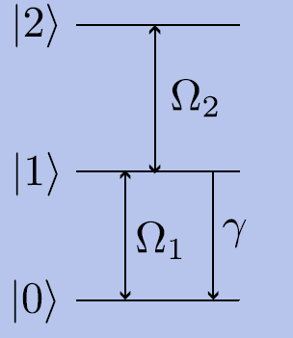
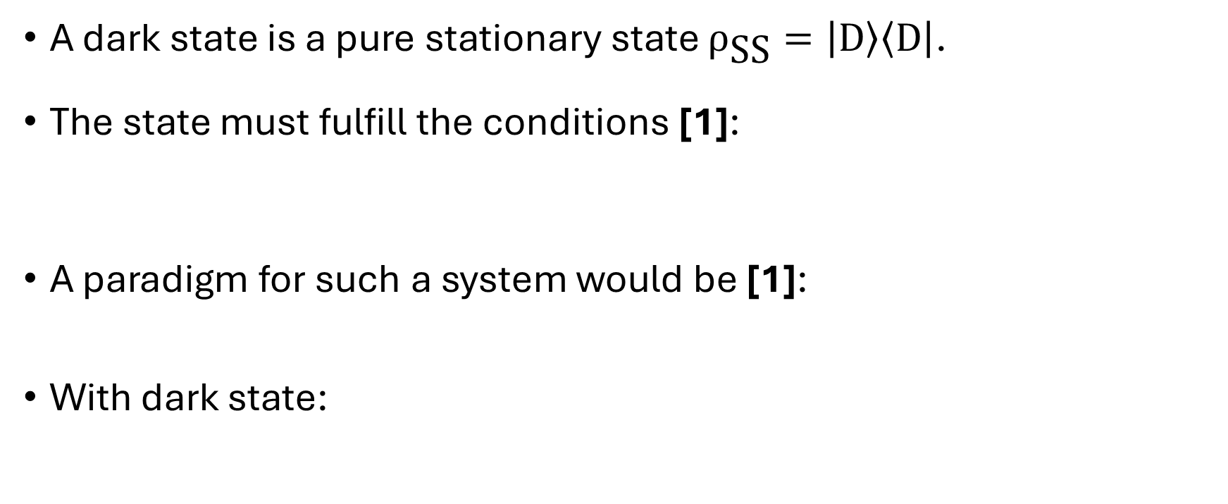


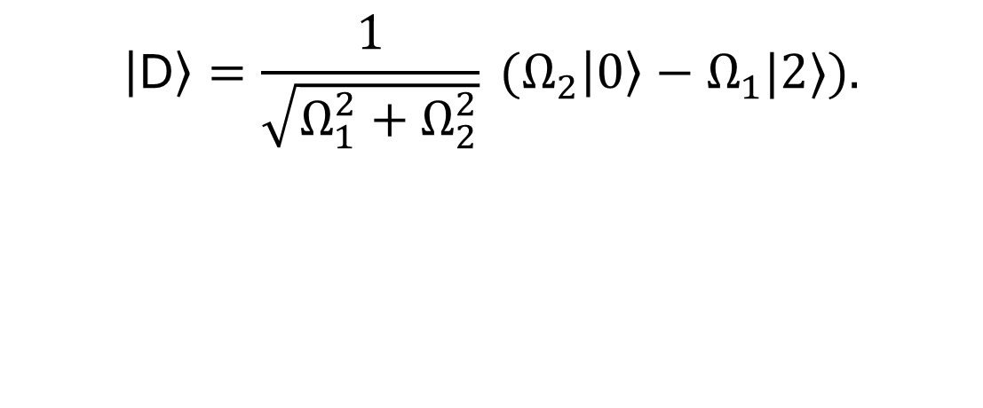
Theoretical backgrounds: Dark states
A dark state is a pure stationary state $ρ_{\text{SS}}=\left|\text{D}\right\rangle \left\langle \text{D}\right|$.
The state must fulfill the conditions [1]:
A paradigm for such a system would be [1]:
With dark state:
$$H\left|\text{D}\right\rangle =E\left|\text{D}\right\rangle ,$$
$$L_{k}\left|\text{D}\right\rangle =0,∀k.$$
$H=Ω_{2} ( |1⟩⟨2|+\left|2\right\rangle ⟨1|)+Ω_{1}( |0⟩⟨1|+|1⟩⟨0| )$.
$$\left|\text{D}\right\rangle =\frac{1}{\sqrt{Ω_{1}^{2}+Ω_{2}^{2}}} (Ω_{2}\left|0\right\rangle −Ω_{1}|2⟩).$$
[1] M. O. Scully und M. S. Zubairy, Quantum Optics, Cambridge University Press, Cambridge, 1997.

Slide 8
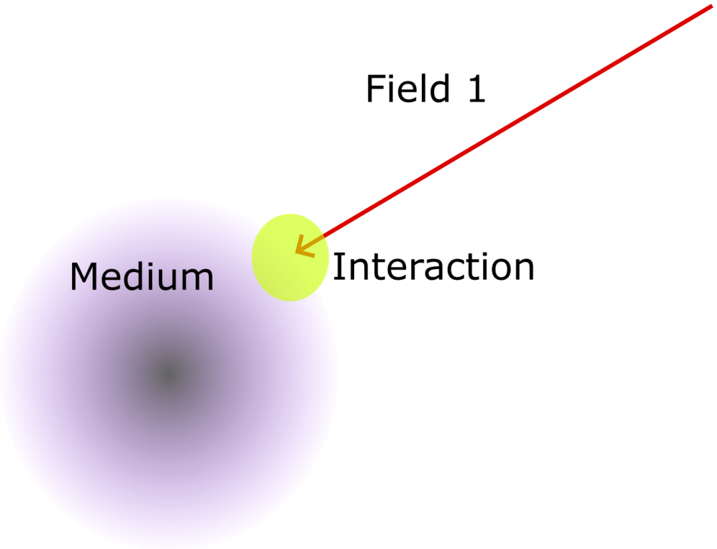
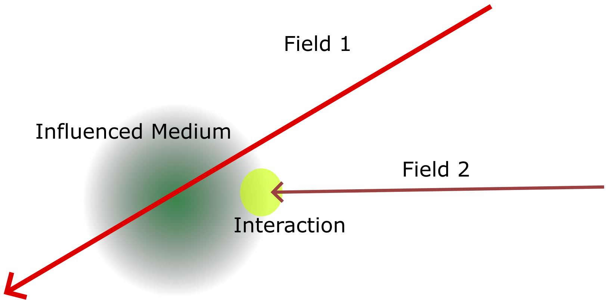
Theoretical backgrounds: EIT (electromagnetically induced transperency)
Associated with dark states is electromagnetically inducedtransparency (EIT).
Opaque medium becoming transparent [1].
A medium needs to be atleast 3-level for EIT [1].
[1] M. Fleischhauer, A. Imamoglu, and J. P. Marangos, “Electromagnetically induced trans-
parency: optics in coherent media

Slide 9
Theoretical backgrounds: EIT
A stationary state is a dark state if decoupled from a certain interaction (cavity field in our case).
Transition matrix elements (such as dipole moments) vanish.
State is immune to certain loss mechanisms e.g. cavity losses.

Slide 10
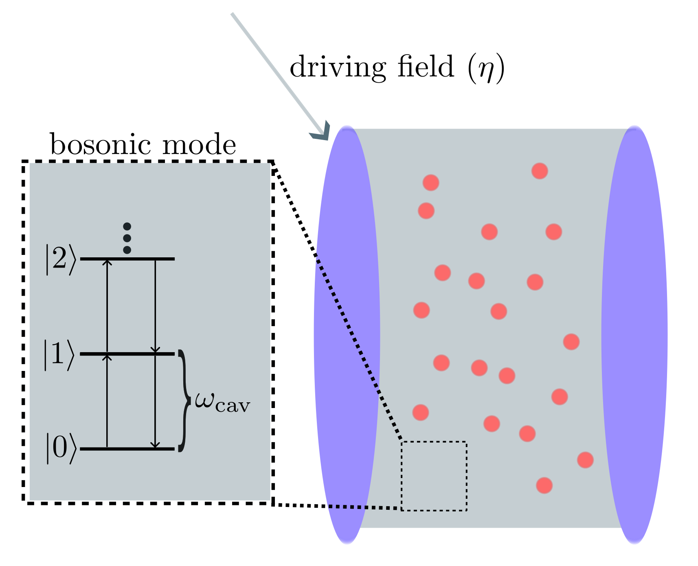
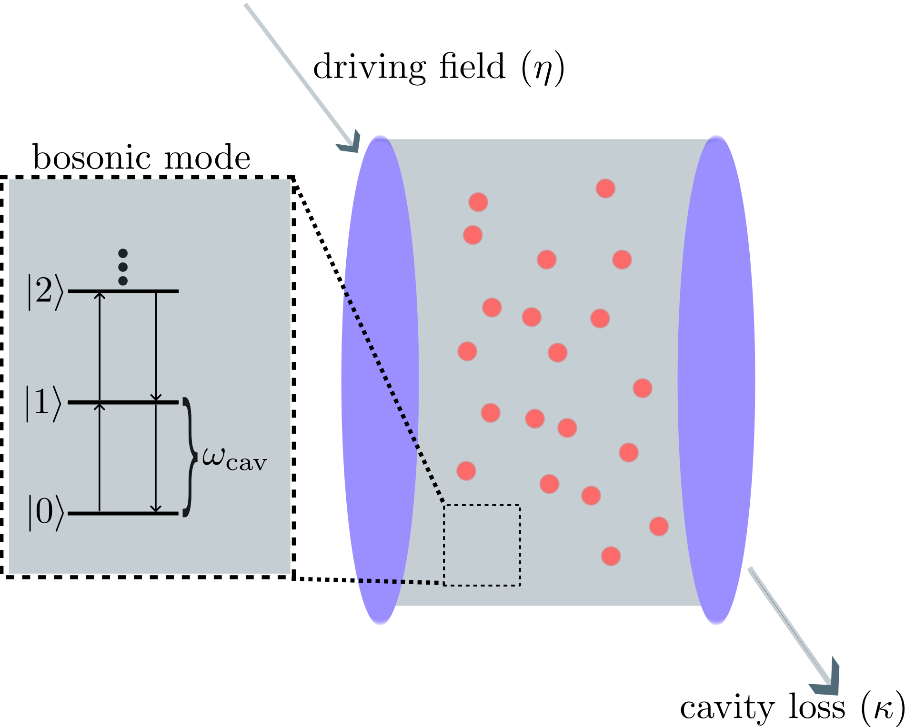
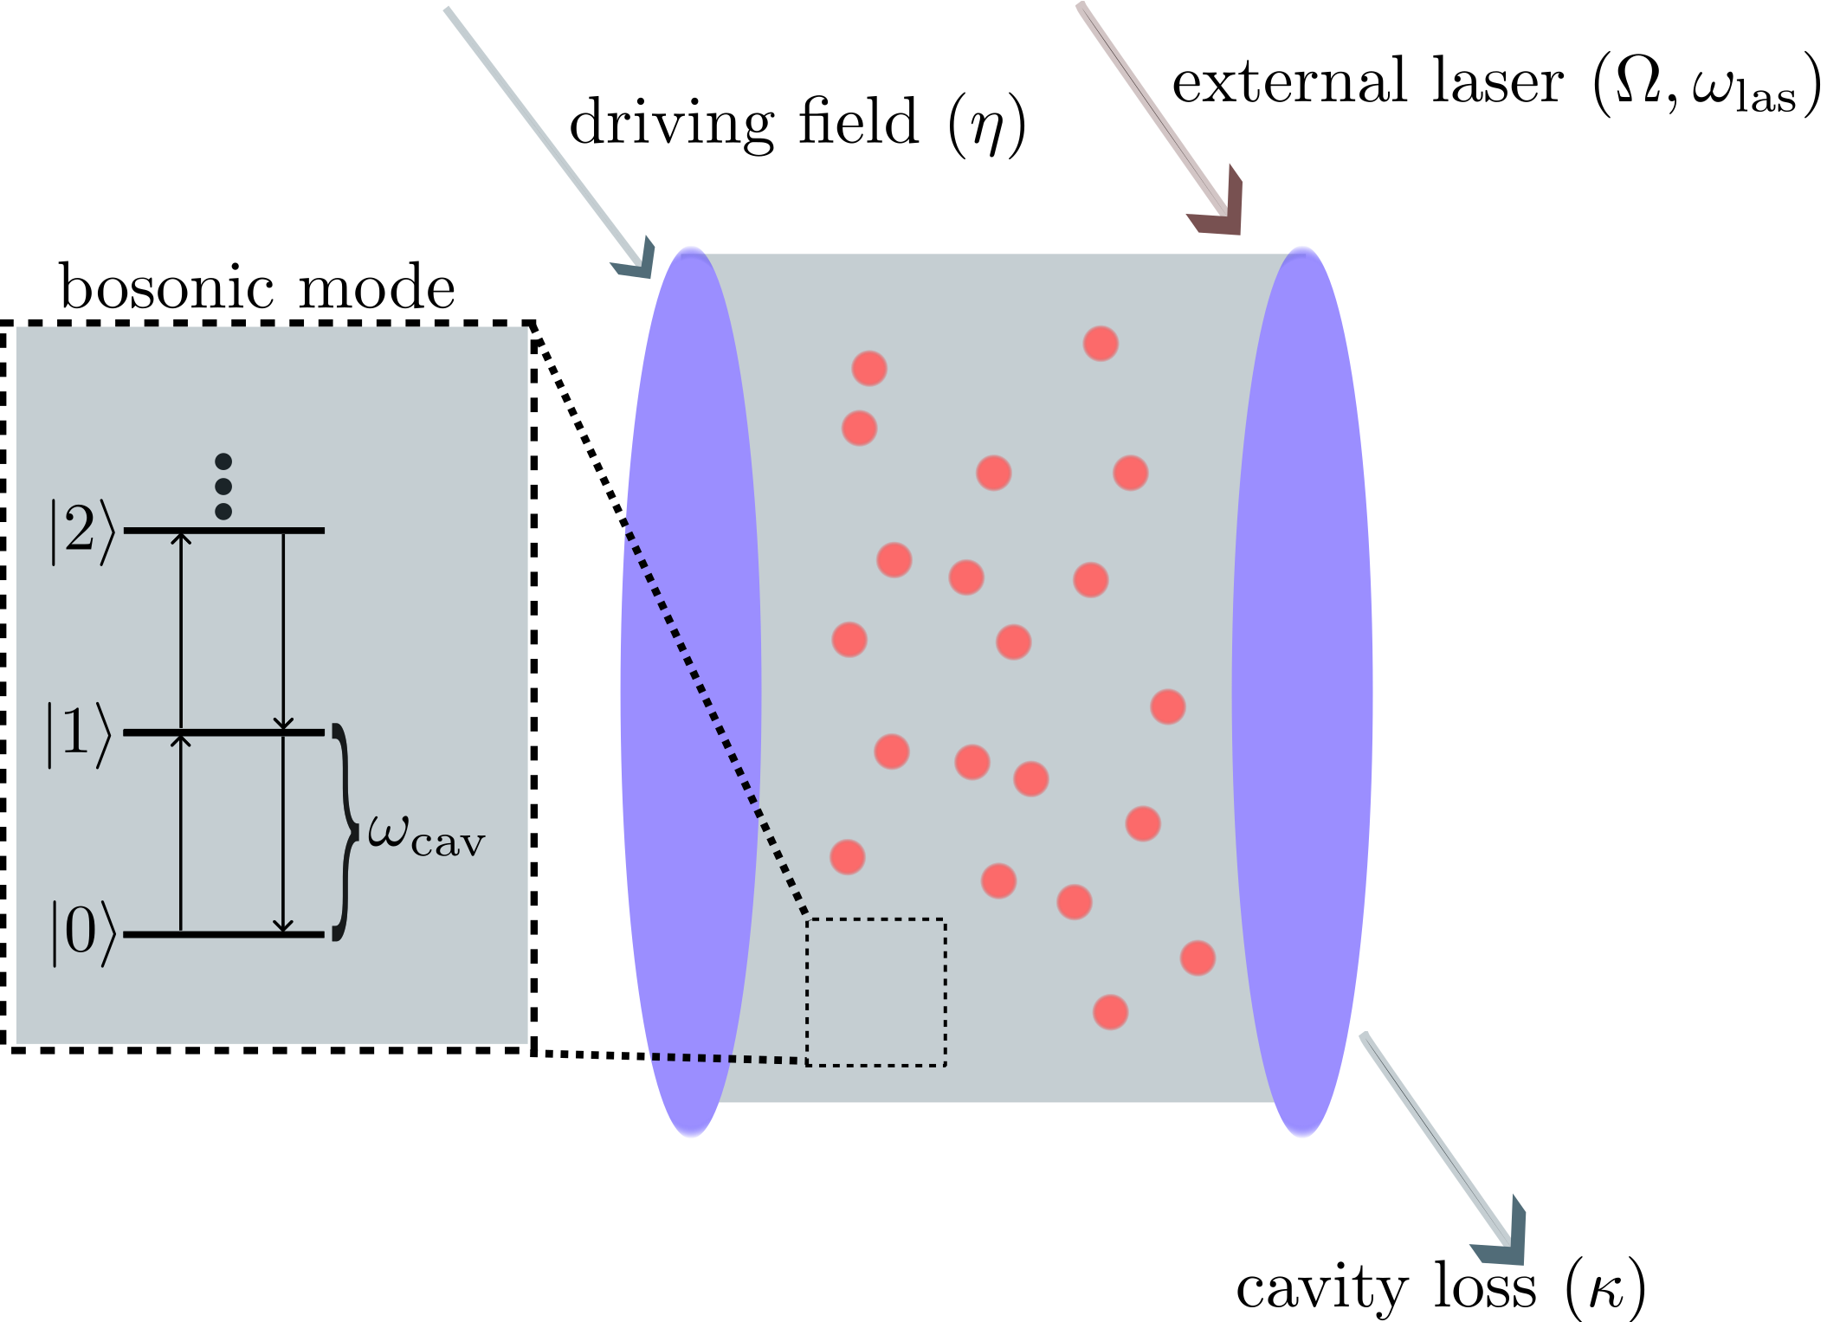
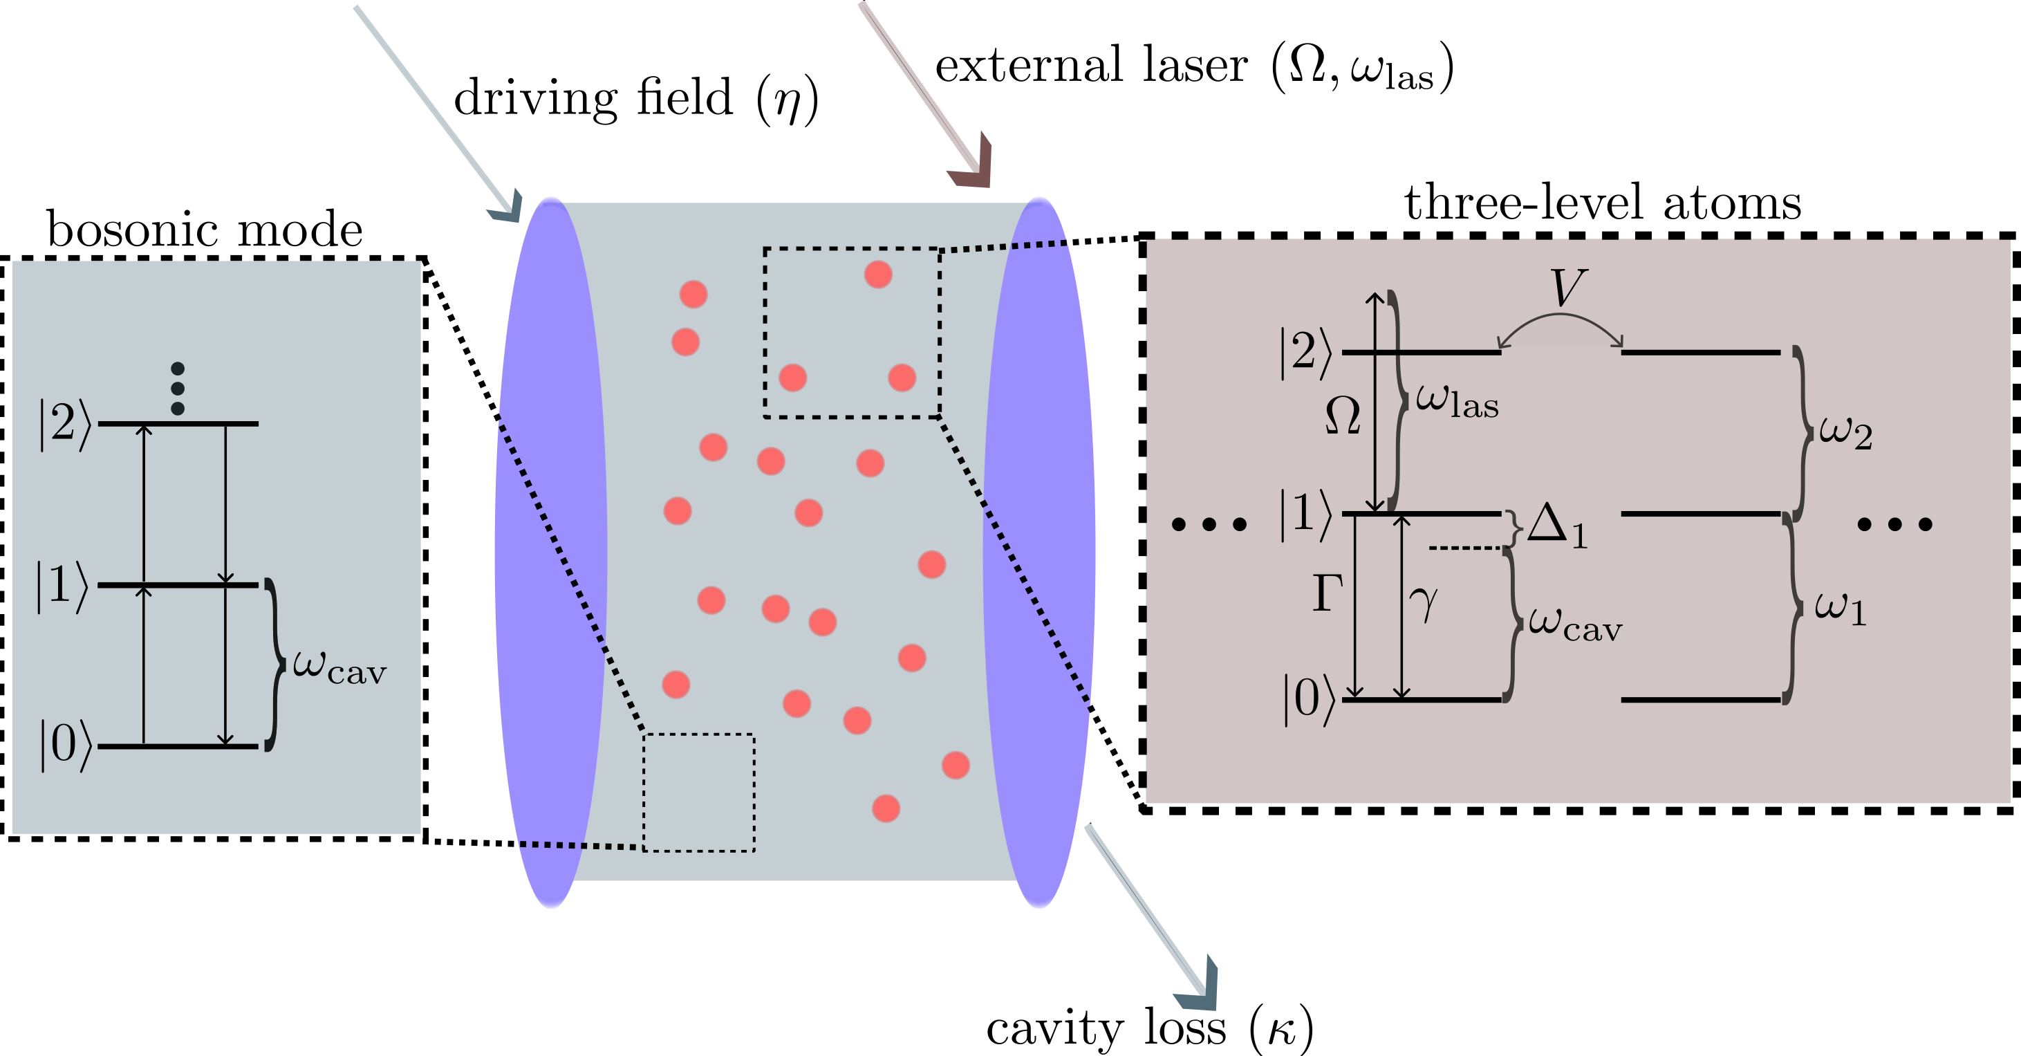
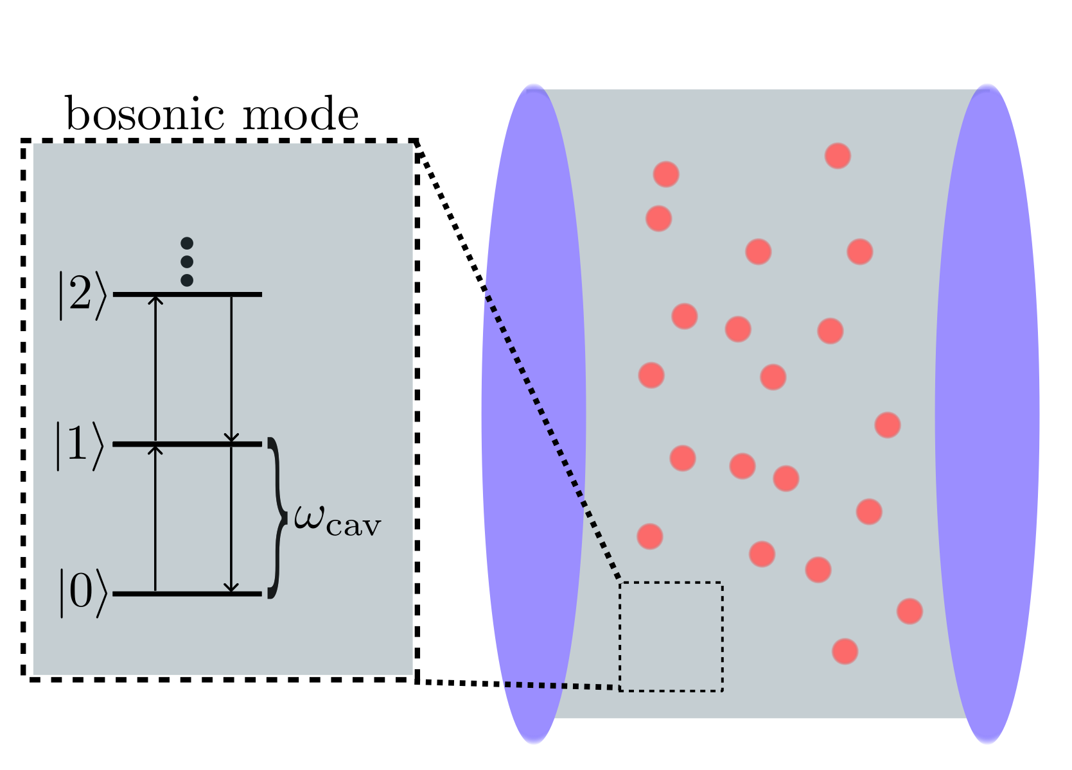
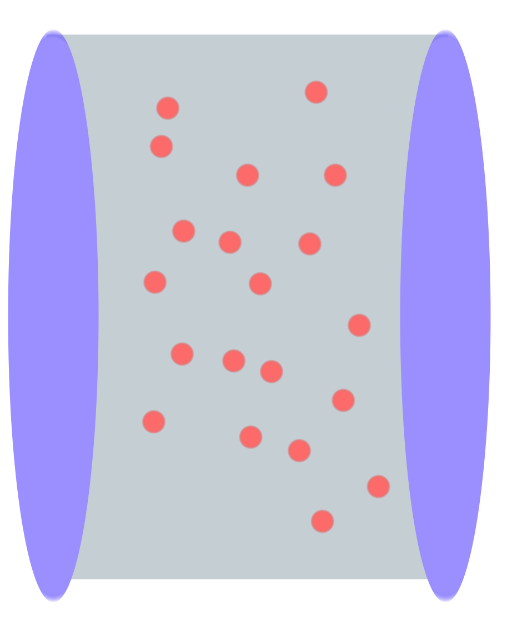
Framework
What are we looking at?
Three-level atoms in optical cavity.

Slide 11
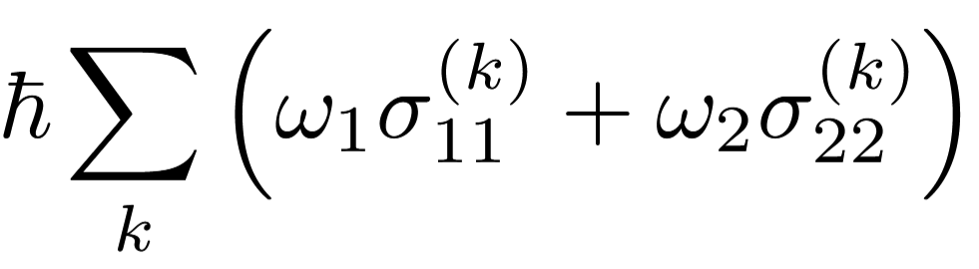
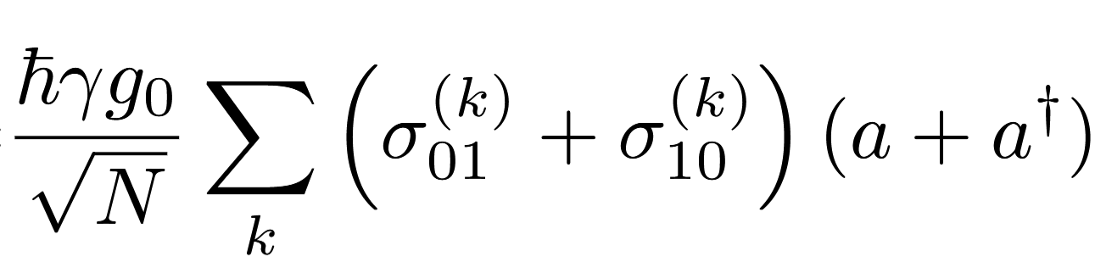
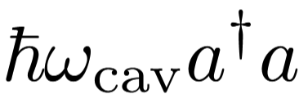
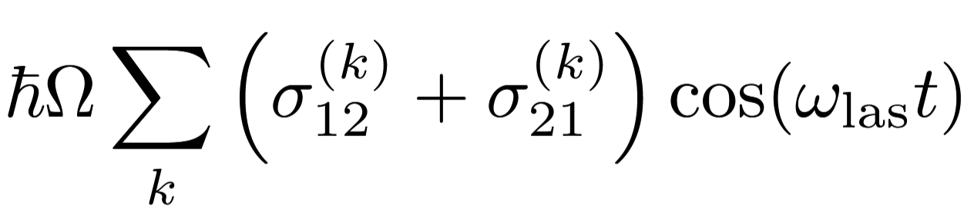
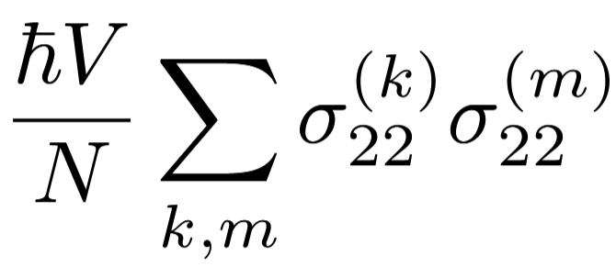
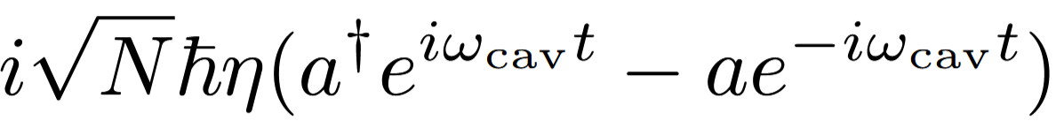
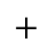
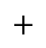
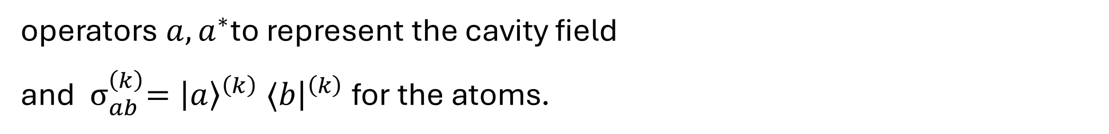
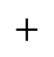
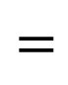
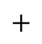
Framework
How do we describe this ?
operators $a,a^{∗}$to represent the cavity field
and ${ σ}_{ab}^{\left(k\right)}={\left|a\right\rangle }^{\left(k\right)} ⟨b{\left.​\right|}^{\left(k\right)}$ for the atoms.
The Hamiltonian:
$$H=H_{\text{cav}}+H_{\text{at}}+H_{\text{int}}+H_{\text{las}}+H_{\text{at}\text{−}\text{at}}+H_{\text{pump}},$$
$$=$$
$$+$$
$$+$$
$$+$$
$$+$$
$$+$$
To simplify, switch to rotating frame.

Slide 12
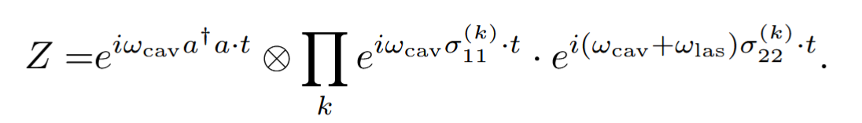
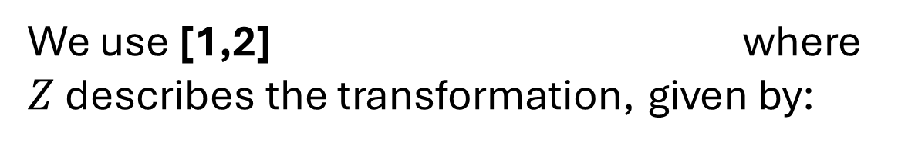
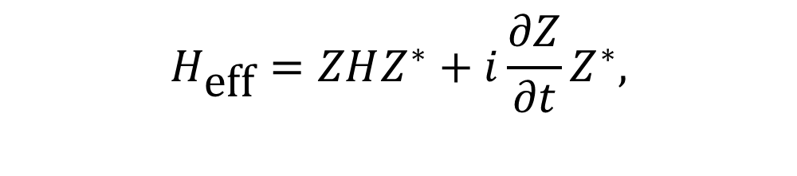
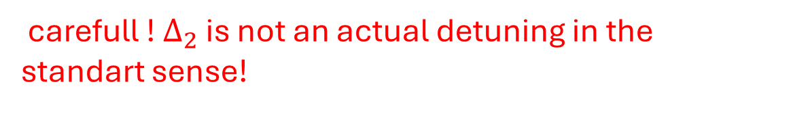
Hamiltonian time independent after transformation.
$$H_{\text{eff}}=ZHZ^{∗}+i\frac{∂Z}{∂t}Z^{∗},$$
We use [1,2] where $Z$ describes the transformation, given by:
[1] M. O. Scully and M. S. Zubairy, Quantum optics
[2] C. Gerry and P. Knight, Introductory quantum optics
We used a RWA (Rotating wave approximation).
The time independent Hamiltonian in the rotating frame reads
$$H_{\text{eff}}=ℏ\sum_{k}{\left[\left(Δ_{1}σ_{11}^{\left(k\right)}+Δ_{2}{σ }_{22}^{\left(k\right)}\right)+\frac{γg_{0}}{\sqrt{N}}\left(σ_{01}^{\left(k\right)}a^{∗}+σ_{01}^{\left(k\right)}a\right)+\frac{Ω}{2}\left(σ_{12}^{\left(k\right)}+σ_{21}^{\left(k\right)}\right)+i\sqrt{N}η\left(a^{∗}−a\right)\right]}+ℏ\frac{V}{N}\sum_{k,n}{{ σ}_{22}^{\left(k\right)}σ_{22}^{\left(n\right)},}$$
carefull ! $Δ_{2}$ is not an actual detuning in the standart sense!

Slide 13
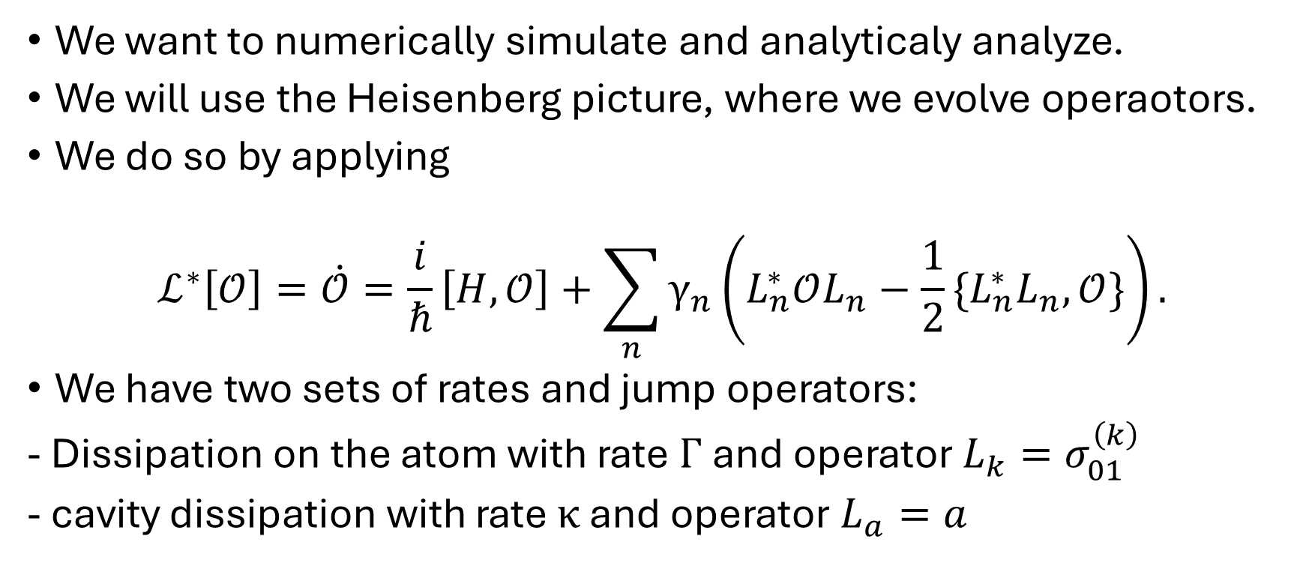
Framework - Equations of motion
We want to numerically simulate and analyticaly analyze.
We will use the Heisenberg picture, where we evolve operaotors.
We do so by applying
$$ℒ^{∗}\left[𝒪\right]=\dot{𝒪}=\frac{i}{ℏ}\left[H,𝒪\right]+\sum_{n}{γ_{n}\left(L_{n}^{∗}𝒪L_{n}−\frac{1}{2}\{L_{n}^{∗}L_{n},𝒪\}\right)}.$$
We have two sets of rates and jump operators:
- Dissipation on the atom with rate$Γ$and operator $L_{k}=σ_{01}^{\left(k\right)}$
- cavity dissipation with rate $κ$ and operator $L_{a}=a$

Slide 14
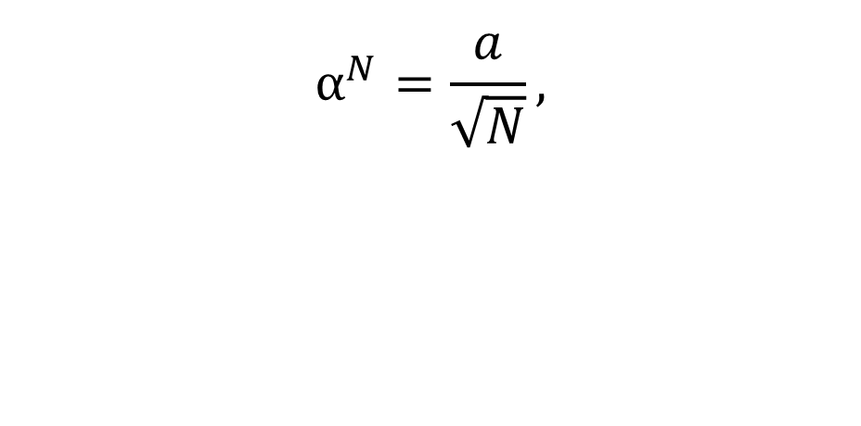
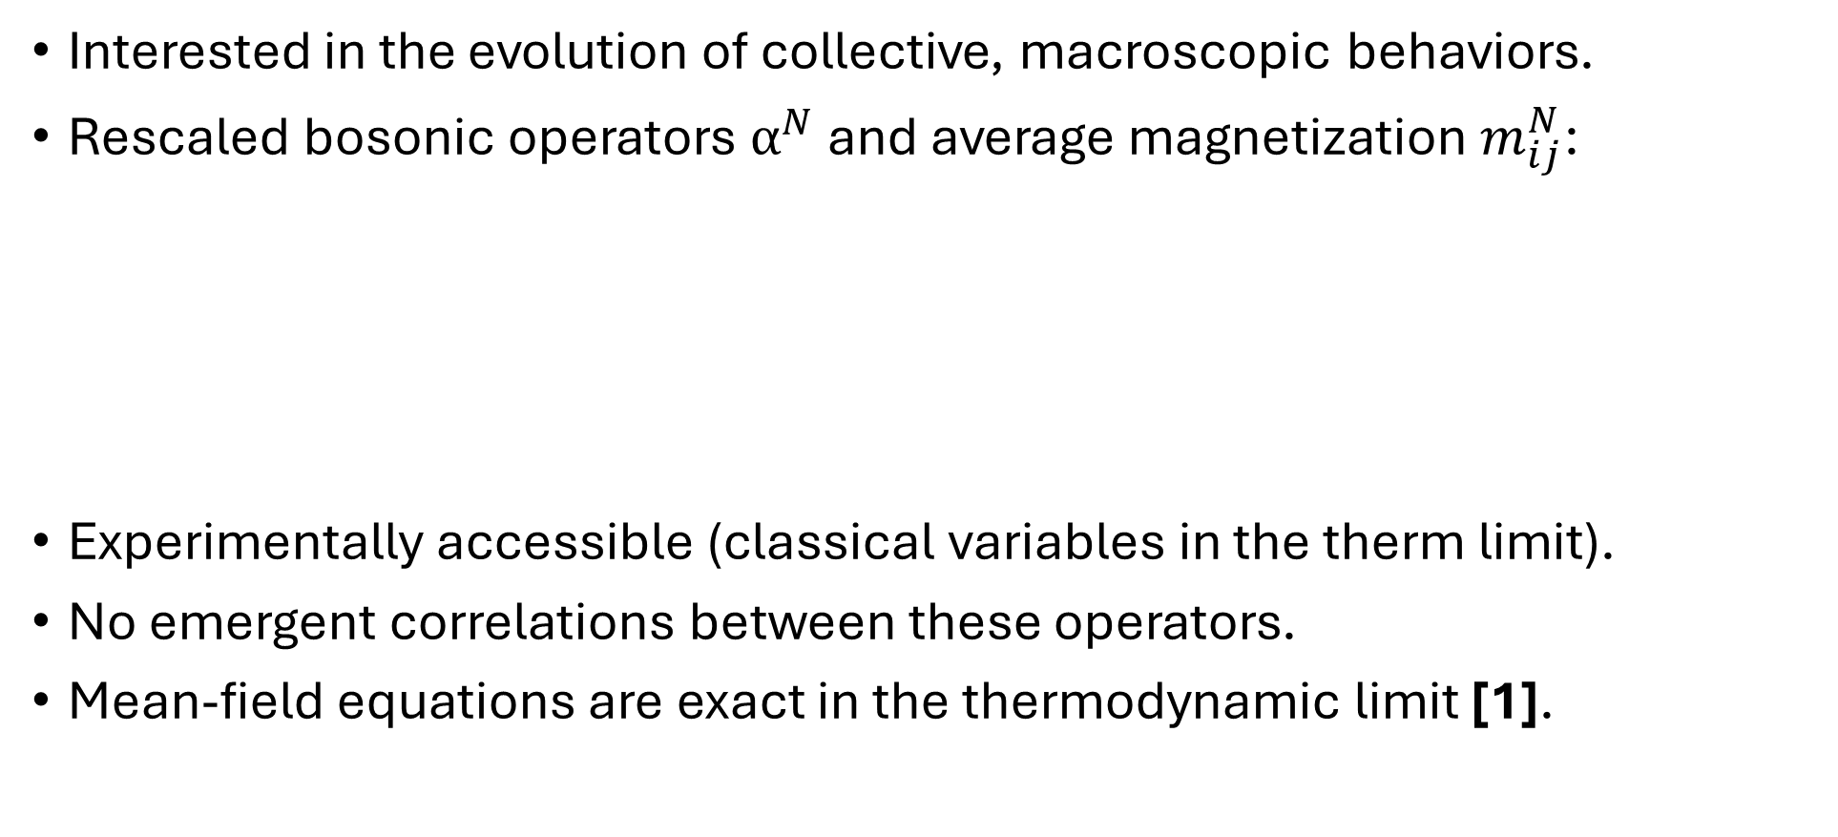
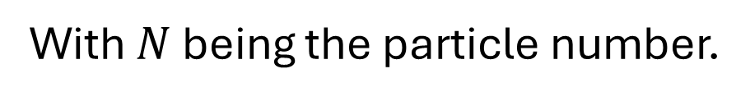

Interested in the evolution of collective, macroscopic behaviors.
Rescaled bosonic operators $α^{N}$ and average magnetization $m_{ij}^{N}$:
Experimentally accessible (classical variables in the therm limit).
No emergent correlations between these operators.
Mean-field equations are exact in the thermodynamic limit [1].
$$m_{ij}^{N}=\frac{\sum_{k=1}^{N}{{ σ}_{ij}^{\left(k\right)}}}{N}.$$
$$α^{N}=\frac{a}{\sqrt{N}},$$
With $N$ being the particle number.
[1] F. Carollo and I. Lesanovsky „ Exactness of Mean-Field Equations for Open Dicke Models with an Application to Pattern Retrieval Dynamics”

Slide 15
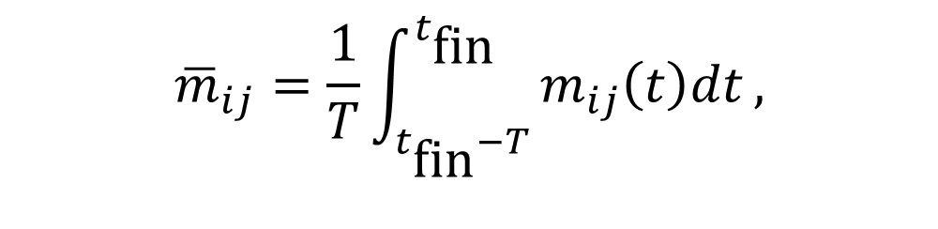
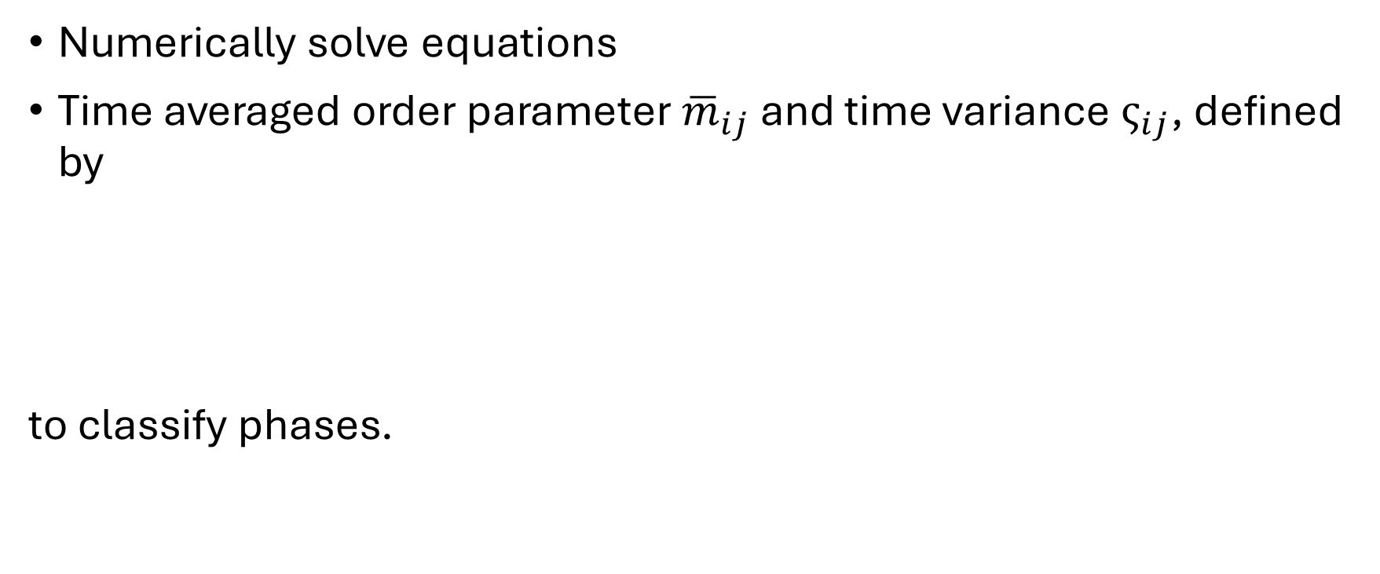
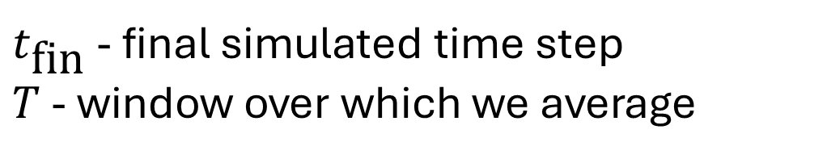
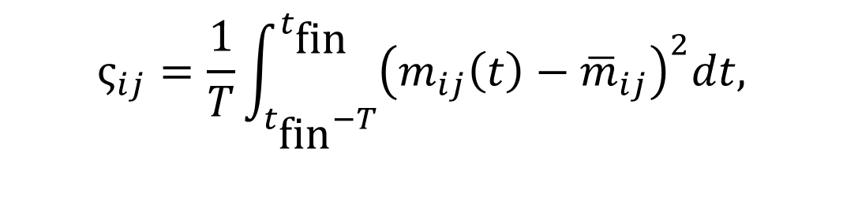
Phase diagram
Numerically solve equations
Time averaged order parameter ${\overline{m}}_{ij}$ and time variance $ς_{ij}$, defined by
to classify phases.
$${\overline{m}}_{ij}=\frac{1}{T}\int_{t_{\text{fin}}−T}^{t_{\text{fin}}}{m_{ij}\left(t\right)dt},$$
$$ς_{ij}=\frac{1}{T}\int_{t_{\text{fin}}−T}^{t_{\text{fin}}}{{\left(m_{ij}\left(t\right)−{\overline{m}}_{ij}\right)}^{2}dt,}$$
$t_{\text{fin}}$ - final simulated time step
$T$ - window over which we average

Slide 16
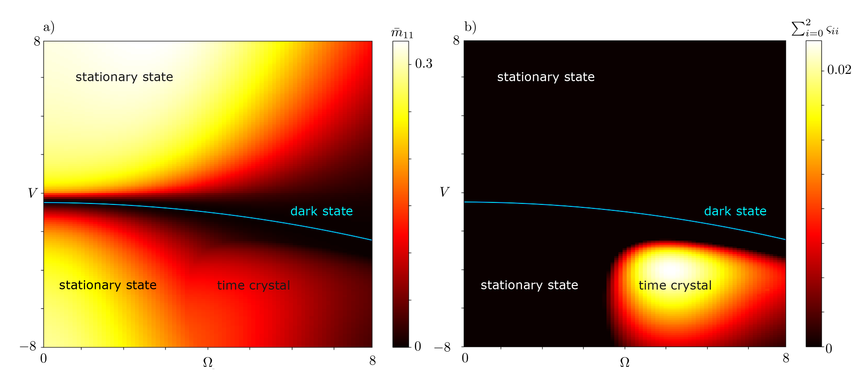
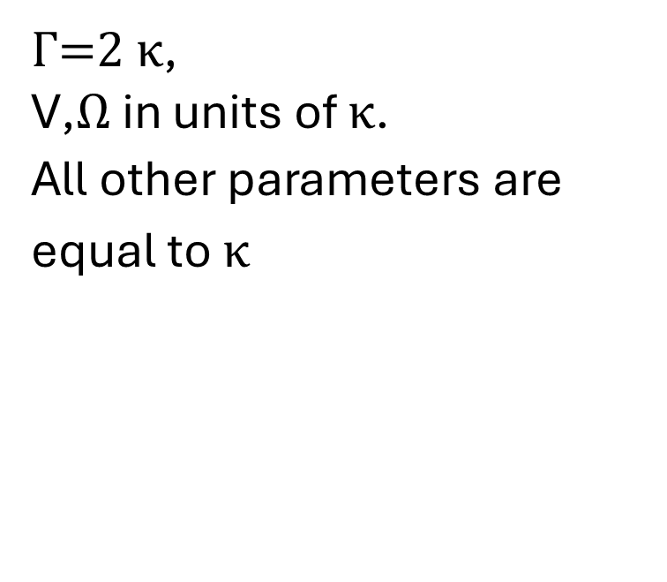
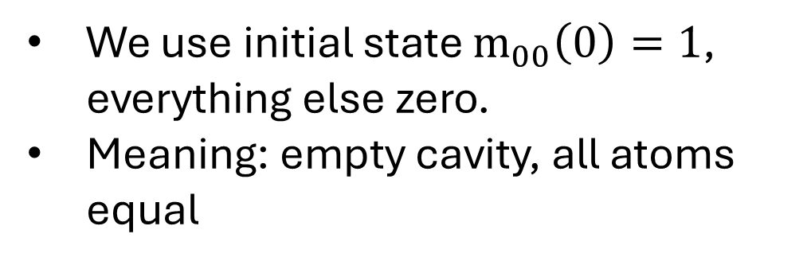
$Γ$=2 $κ$,
$\text{V}$,$Ω$ in units of $κ$.
All other parameters are equal to $κ$
We use initial state ${\text{m}}_{00}\left(0\right)=1$, everything else zero.
Meaning: empty cavity, all atoms equal

Slide 17




We analytically cant find stationary, but dark state!
For finding the dark state we use the ansatz
Applying to the condtions
The condition for a stationary state being dark is
$$\left|\text{D}\right\rangle =c_{1} \left|0\right\rangle +c_{2} \left|2\right\rangle .$$
$$H\left|\text{D}\right\rangle =E\left|\text{D}\right\rangle ,$$
$$L_{k}\left|\text{D}\right\rangle =0,∀k.$$
$$V=V_{\text{D}}=−\frac{Δ_{2}}{2}\left({\left(\frac{Ωκ}{4ηγg_{0}}\right)}^{2}+1\right).$$

Slide 18


Is it possible to interpret this dark state to EIT ?
Yes.
No interaction with first excited state!
Bosonic and atomic systems are decoupled!
This state is emergent -> only exact in thermodynamic limit.
No dynamics appear in this state.
$\dot{α}=\frac{−κα}{2}+η$,
${\dot{m}}_{00}=0$,
${\dot{m}}_{11}=0$,
${\dot{m}}_{22}=0$,
${\dot{m}}_{20}=i\left(Δ_{2}m_{20}+2Vm_{20}m_{22}\right)$,
${\dot{m}}_{21}=i\left(−γg_{0}m_{20}α+\frac{Ω}{2}m_{11}\right)$.

Slide 19


Here $Δ_{1}=Δ_{2}=−κ$

Slide 20


Here $Δ_{1}=Δ_{2}=0$. No time crystal can be found!

Slide 21



$Δ_{1}=Δ_{2}=0,Ω=κ$.

Slide 22
Stability
Dark state and mixed stationary state stability:
Small perturbations and linearistation were used.
Found to be stable for investigated parameters.
Time crystal stability using Floquet analysis
Stable for the investigated regions.
No coexistence could be found or indicated. (Using method of [1])
[1] R. Mattes, I. Lesanovsky, and F. Carollo, “Entangled time-crystal phase in an open quantum
light-matter system

Slide 23

Outlook and conclusion
Investigate quantum fluctuations.
Compare with real experimental data of similar systems.
Explore more parameter regimes for $η$ and $Ω$, for different couplings and dissipations.
A general dark state condition for this system was found.
Dark state was linked to EIT.
Stability was analyzed.
Thanks for your attention!

Slide 24

Time crystal extra material

Slide 25

Limit cycle in magnetization space

Slide 26



Stationary- / Dark- state stability
We define a fixed point and slightly perturb the system.
We approximate by performing a Taylor expansion, only retaining linear terms.
The full system equations read

Slide 27

Our equations of motion read
$\dot{α}\left(t\right) =−\frac{κα\left(t\right)}{2}−iγg_{0}m_{01}\left(t\right)+η,$
${\dot{m}}_{00}\left(t\right)=Γm_{11}\left(t\right)+iγg_{0}\left(m_{10}\left(t\right)α\left(t\right)−m_{01}\left(t\right)α^{∗}\left(t\right)\right)$,
${\dot{m}}_{11}\left(t\right)=−Γm_{11}\left(t\right)+iγg_{0}\left(m_{01}\left(t\right)α^{∗}\left(t\right)−m_{10}\left(t\right)α\left(t\right)\right)+\frac{iΩ}{2}\left(m_{21}\left(t\right)−m_{12}\left(t\right)\right)$,
${\dot{m}}_{22}\left(t\right)=i\frac{Ω}{2}\left(m_{12}\left(t\right)−m_{21}\left(t\right)\right)$,
${\dot{m}}_{21}\left(t\right)=−\frac{Γ}{2}m_{21}\left(t\right)+i\left(Δ_{2}m_{21}\left(t\right)−Δ_{1}m_{21}\left(t\right)−γg_{0}m_{20}\left(t\right)α\left(t\right)\right) i\left(+\frac{Ω}{2}\left(m_{11}\left(t\right)−m_{22}\left(t\right)\right)+2Vm_{21}\left(t\right)m_{22}\left(t\right)\right)$,
${\dot{m}}_{01}\left(t\right)=−\frac{Γ}{2}m_{01}\left(t\right)+i\left(−Δ_{1}m_{01}\left(t\right)+γg_{0}\left(m_{11}\left(t\right)α\left(t\right)−m_{00}\left(t\right)α\left(t\right)\right)−\frac{Ω}{2}m_{02}\left(t\right)\right)$,
${\dot{m}}_{20}\left(t\right)=i\left(Δ_{2}m_{20}\left(t\right)+\frac{Ω}{2}m_{10}\left(t\right)+2Vm_{20}\left(t\right)m_{22}\left(t\right)−γg_{0}m_{21}\left(t\right)α^{∗}\left(t\right)\right)$.

Slide 28



for certain small $Γ$values, positive eigenvalues appear, indicating instability.
$Γ$=2 $κ$, $Δ_{1}=Δ_{2}=−κ$
$\text{V}$,$Ω$ in units of $κ$.
All other parameters are equal to $κ$

Slide 29

$ω_{\text{cav}}$ - cavity frequency
$ω_{\text{las}}$ - laser frequency (resonant with cavity)
$ω_{\text{1}}$, $ω_{\text{2}}$ - cavity transition frequencys
$η$– driving field amplitude
$Γ$ – atomic dissipation rate
$κ$ – cavity dissipation rate
$γ$ - transition between zero and one
$Δ_{1}$- detuning of first excited state
$Ω$ – Rabi frequency of external laser
$\text{V}$ – all to all atom interaction potential

